Slide 1





Launched in 2001, Sensors (ISSN: 1424-8220) is the leading international, peer-reviewed, open access journal on the science and technology of sensors. Sensors is published semimonthly online by MDPI.
Sensors in Numbers
IF & CiteScore
Article Processing Time
Founded: 2001 (Volumes: 26)
42,900+ articles cited 10+ times
H5-Index: 210
Impact Factor: 4.0
Q2 in ‘Instruments & Instrumentation’
Q2 in ‘Engineering, Electrical & Electronic’
Q2 in ‘Chemistry, Analytical’
CiteScore: 9.4
Q1: Instrumentation
43 Days
Median Processing Time
2.8 Days
Acceptance to publication
17.8 Days
Time to First Decision
(data from the first half of 2026)
High Visibility: indexed within Scopus, SCIE (Web of Science), PubMed, PMC, Ei Compendex, and other databases
Notes:
69,843 Papers published

Slide 2



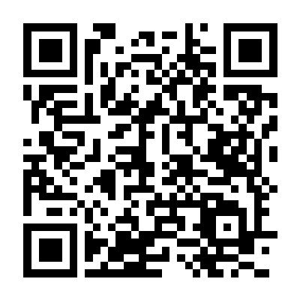


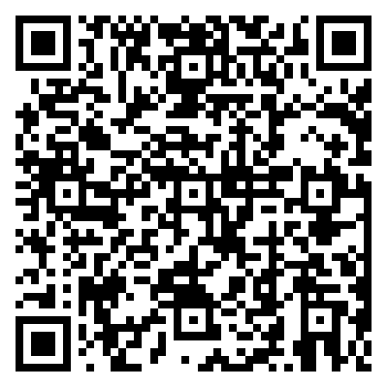


Section Introduction
The "Fault Diagnosis & Sensors" Section aims original research, related to advanced methods, technologies and systems for fault diagnosis, failure prognosis and non-destructive testing, using various sensor types for multiple industrial applications: aerospace, power generation, oil and gas, construction, transport, manufacturing and many others.
Editor’s Choice Article
Fault Detection in Induction Machines Using Learning Models and Fourier Spectrum Image Analysis
Recommended Special Issue
Sensor-Based Condition Monitoring and Non-Destructive Testing
Deadline: 31 December 2026
Section Editor-in-Chief
Prof. Dr. Tielin Shi
Huazhong University of Science and Technology, China
Section Associate Editor
Prof. Dr. Andrea Cataldo
University of Salento, Italy
Prof. Dr. Len Gelman
University of Huddersfield, UK
Prof. Dr. Yi Qin
Chongqing University, China

Slide 3



Machines is an international, peer-reviewed, open access journal on machinery and engineering, published monthly online by MDPI. The International Federation for the Promotion of Mechanism and Machine Science (IFToMM) is affiliated with Machines and its members receive a discount on the article processing charges.
Journal Rank: JCR - Q2 in Engineering, Mechanical (73/184) and Engineering, Electrical and Electronic (171/369)
Scope
machines design and theory
machines testing and maintenance
electromechanical energy conversion systems
electrical machines and drives
condition monitoring and diagnostics
automation and control
electromechatronics
mechatronics and intelligent machines
advanced manufacturing
vehicle engineering
turbomachinery
friction and tribology
Article Processing Time
15.9
days submission to revision
2.9
days acceptance to publication
39
days submission to publication
*Note: median values for papers published in this journal in the first half of 2026.

Slide 4


Joint Special Issue
Sensor-Based Condition Monitoring and Non-Destructive Testing
Topics include, but are not limited to:
Condition monitoring
Non-destructive testing
Classical, time–frequency and higher-order signal processing
Adaptation of sensor-based monitoring/testing technologies
Guest Editor
Prof. Dr. Len Gelman
Deadline
31 December 2026

